Slide 1
Introduction to treebanks

Slide 2
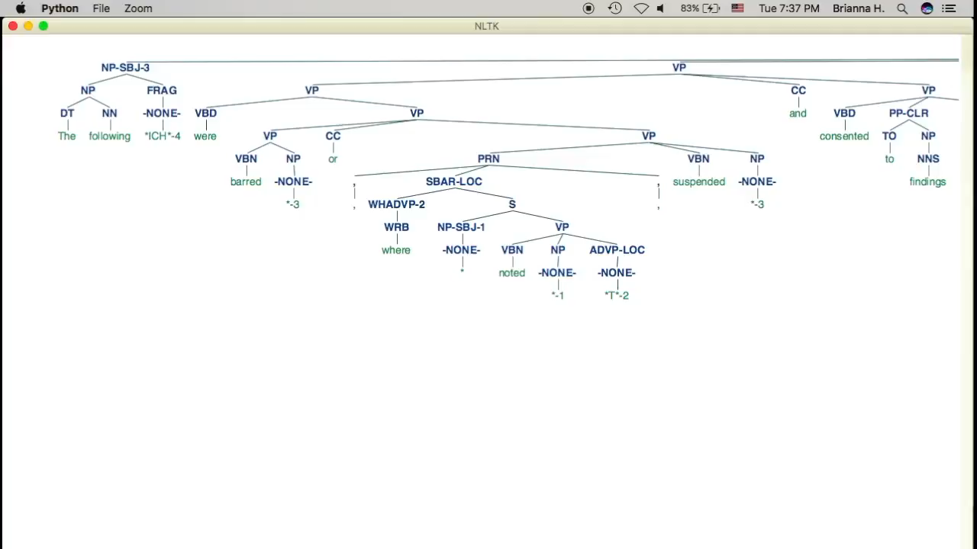

Slide 3
Outline
Types of treebanks
(Syntactic) Treebank
PropBank
Discourse Treebank
The English Penn Treebank
Why do we need treebanks?

Slide 4
(Syntactic) Treebank
Sentences annotated with syntactic structure (dependency structure or phrase structure)
1960s: Brown Corpus
Early 1990s: The English Penn Treebank
Late 1990s: Prague Dependency Treebank
1990s – now: Arabic, Chinese, Dutch, Finnish, French, German, Greek, Hebrew, Hindi, Hungarian, Icelandic, Italian, Japanese, Korean, Latin, Norwegian, Polish, Spanish, Turkish, etc.

Slide 5
An example
John loves Mary .
S
NP
VP
./.
John/NNP
loves/VBP
NP
(S (NP (NNP John))
(VP (VBP loves)
(NP (NNP Mary)))
(. .))
Mary/NNP
loves/VBP
John/NNP Mary/NNP
./.

Slide 6
PropBank
Sentences annotated with predicate argument structure
Ex: John loves Mary
“loves” is the predicate
“John” is Arg0 (“Agent”)
“Mary” is Arg1 (“Theme”)
2000s: The English PropBank, followed by the PropBanks for Chinese, Arabic, Hindi/Urdu, etc.

Slide 7
Discourse Treebank
2006-2008: The English Discourse Treebank
The city’s Campaign Finance Board has refused to pay Mr. Dinkins $95,142 in matching funds because his campaign records are incomplete.

Slide 8
Multi-representational, multi-layered treebank
2010-: Multi-representational, multi-layer Treebank for Hindi/Urdu
The treebank includes both PS, DS, and PB.
S
loves/VBP
John/NNP Mary/NNP
NP
VP
./.
./.
John/NNP
loves/VBP
NP
“loves” is predicate. “John” is Arg0. “Mary” is Arg1.
Mary/NNP

Slide 9
The English Penn Treebank (PTB)
Developed at UPenn in early 1990s
Most commonly used treebank in the CL field
Data:
WSJ: 1-million words from 1987 to 1989
Others: Brown Corpus, ATIS, etc.
Release:
1992: version 1
1995: version 2
1999: version 3

Slide 10

An example

Slide 11
The PTB Tagset
Syntactic labels: e.g., NP, VP
Function tags: e.g., -SBJ, -LOC
Empty categories (ECs): e.g., *T* (for A-bar movement)
Sub-categories for ECs: e.g., 0 (zero complementizers), NP* (PRO, A-movement)

Slide 12
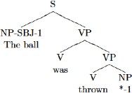
Passive

Slide 13
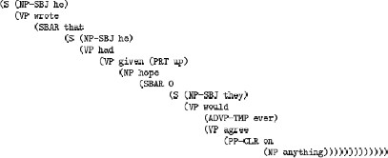
Clausal Complementation

Slide 14
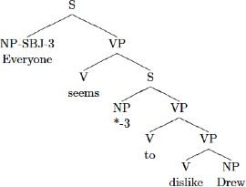
Raising

Slide 15
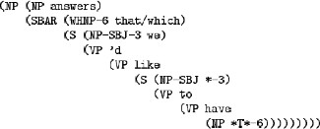
Wh-Relative Clauses

Slide 16
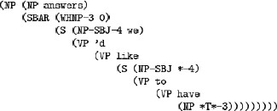
Contact Relatives

Slide 17
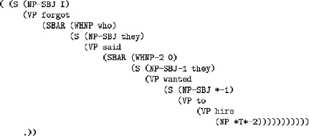
Indirect Questions

Slide 18
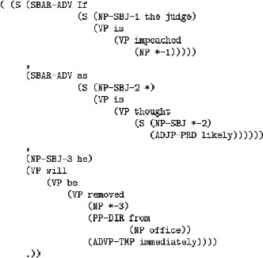
Punctuation

Slide 19
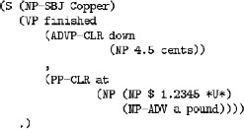
FinancialSpeak

Slide 20
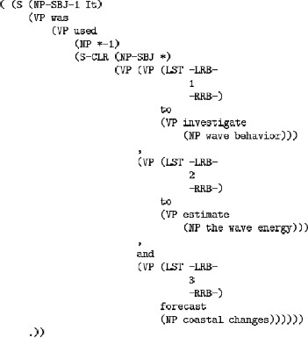
Lists 1

Slide 21
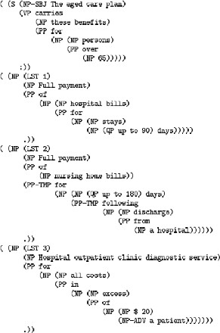
Lists 2

Slide 22
Why do we need treebanks?
Computational Linguistics: (Session 6-7)
To build and evaluate NLP tools (e.g., word segmenters, part-of-speech taggers, parsers, semantic role labelers)
This leads to significant progress of the CL field
Theoretic linguistics: (Session 2 and 5-6)
Annotation guidelines are like a grammar book, with more detail and coverage
As a discovery tool
One can test linguistic theories and collect statistics by searching treebanks.

Slide 23
CL example: Parsing
S => NP VP . NP => NNP VP => VBP NP
Input:
John
loves
Mary .
NNP => John NNP => Mary VBP => loves
. => .
Output:
S
NP
VP
./.
John/NNP
loves/VBP
NP
Mary/NNP

Slide 24
Ambiguity
PP attachment: John bought the book in the store
S => NP VP
NP => PN VP => V NP VP => VP PP NP => NP PP PP => P NP
S
NP
VP
VP
PP
John/NNP
bought/VBP
NP
S
in the store
the book
VP
NP
bought/VBP
NP
John/NNP
NP
PP
the book
in the store
25

Slide 25
Labeled f-score
sys output:
gold standard:
S
S
VP
NP
VP
NP
VP
bought/VBP
2
NP
PP
John/NNP
John/NNP
NP
PP
bought/VBP
NP
1
in the store
1
in the store
2
the book
the book
5,6,7
(1, 7, S)
(1, 1, NP)
(2, 7, VP)
(3, 7, NP)
(3, 4, NP)
(5, 7, PP)
(6, 7, NP)
(1, 7, S)
(1, 1, NP)
(2, 7, VP)
(2, 4, VP)
(3, 4, NP)
(5, 7, PP)
(6, 7, NP)
3,4
5,6,7
3,4
Prec=6/7, recall=6/7,
f-score=6/7

Slide 26
Parsing evaluation
Evaluation:
precision, recall, f-score
Best f-score: around 91%

Slide 27
Thankyou

